Slide 1
Lecture -9
Fourier Integral

Slide 2
Objective
to discuss Fourier sine integral
to discuss Fourier cosine integral

Slide 3
Fourier Integral
Fourier integral is a formula for the decomposition of a non-periodic function into harmonic components whose frequencies range over a continuous set of values.
The Fourier integral of non-periodic function f(x) but piecewise continuous in any infinite interval as follows:
where and

Slide 4

Fourier Integral
Fourier cosine integral:
where and
If the function f(x) is even and writing $v=x$
(even) and (odd)
Hence, the Fourier cosine integral of f(x) is

Slide 5

Fourier Integral
Fourier sine integral:
where and
If the function f(x) is odd then and writing $v=x$
(odd) and (even)
Hence, the Fourier sine integral of f(x) is

Slide 6
Fourier Integral
Useful formula:

Slide 7

Example of Fourier Integral (continued)
Example:
Find the Fourier integral of where and hence prove that
Solution:
$=\frac{2}{π}[0−\frac{1\left(0−w\right)}{w^{2}+4}]$

Slide 8
Example of Fourier Integral (continued)
Hence the Fourier integral of f(x) is,
Now,
(proved)

Slide 9
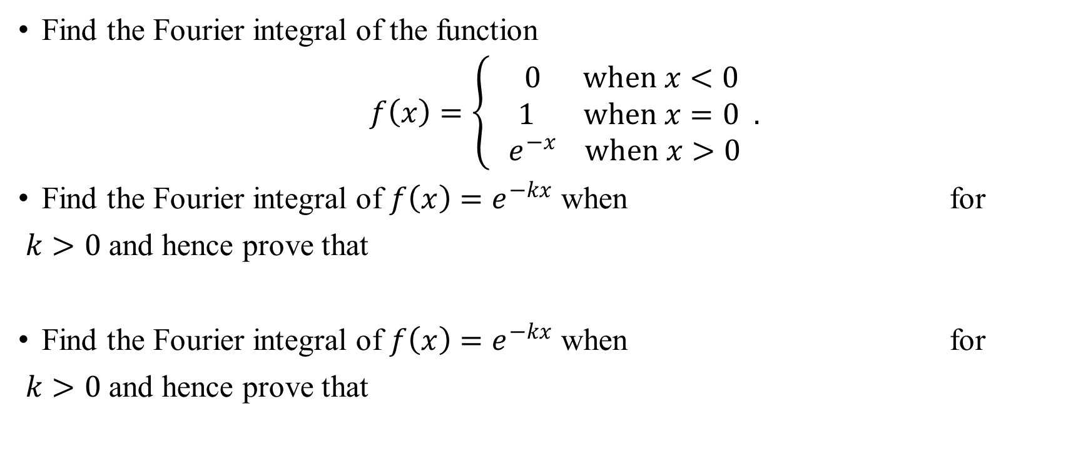
Sample Exercise
Find the Fourier integral of the function
$f\left(x\right)=\left\{\begin{aligned} 0 when x<0 \\ 1 when x=0 . \\ e^{−x} when x>0\end{aligned}\right.$
Find the Fourier integral of $f\left(x\right)=e^{−kx}$ when for
$k>0$and hence prove that
Find the Fourier integral of $f\left(x\right)=e^{−kx}$ when for
$k>0$and hence prove that

Slide 10
Sample MCQ
Which of the following is the formula for Fourier sine integral?
a) b)
c) Both d) none
Which of the following is the formula for Fourier cosine integral?
a) b)
c) Both d) none

Slide 11
Outcome
After this lecture students will be able
to calculate Fourier sine integral
to calculate Fourier cosine integral

Slide 12
Next class
Application of Fourier transform

